Slide 1





AI Powered Medical Diagnosis System
Team : Ashraf Eqbal , Guide: Saomya Chaudhury
ashrafeqbal8@gmail.com
Notes:
Slides: Prepare a short slide deck (10-12 slides) summarizing the project objectives, methodology, and key results.

Slide 2
Introduction
AI-Powered Health Assistant is a machine learning-based web application designed to predict four diseases:
Diabetes
Heart Disease
Parkinson’s Disease
Lung Cancer
Built using Streamlit for an interactive user experience

Slide 3
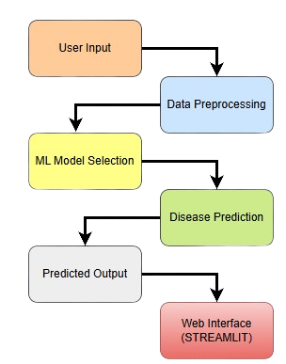
System Architecture
System Flow: 1️⃣ User enters medical details in the web app 2️⃣ Data preprocessing ensures accurate input 3️⃣ Pre-trained machine learning model runs based on selected disease 4️⃣ Prediction result is displayed to the user

Slide 4
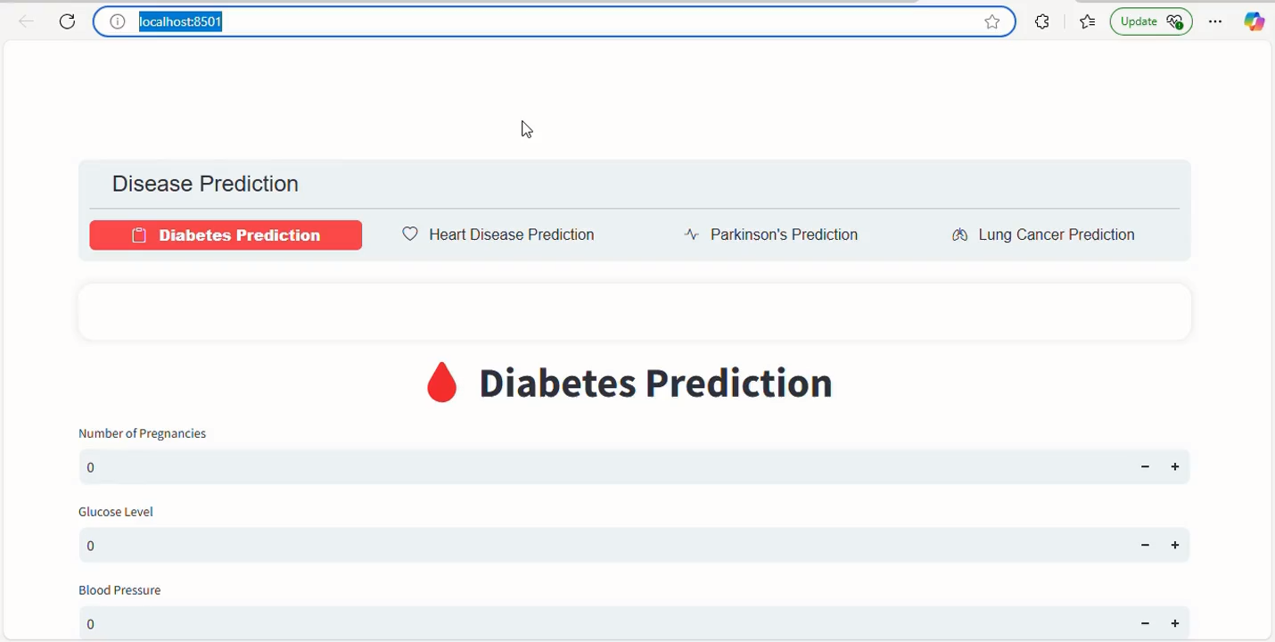
Live Demo of Project

Slide 5
Data Preprocessing
✅ Normalization – Scales data to a uniform range ✅ Handling Missing Data – Uses imputation or prompts user ✅ Feature Selection – Uses only relevant medical parameters

Slide 6
Machine Learning Models
Models chosen based on accuracy and performance
Disease | Model Used
Diabetes | Logistic Regression
Heart Disease | SVM (Support Vector Machine)
Parkinson’s | Logistic Regression
Lung Cancer | Logistic Regression

Slide 7
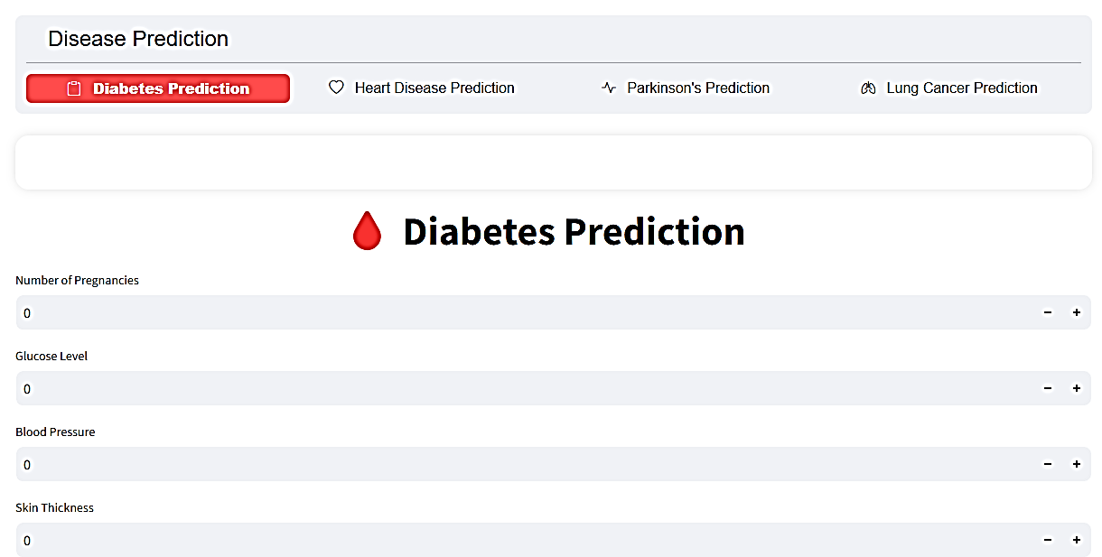
Web Application(Streamlit)
🔹 User-friendly interface for inputting data 🔹 Real-time predictions displayed 🔹 Lightweight and fast processing

Slide 8
Conclusion
✔ AI-powered health assistant provides quick and accurate predictions ✔ Machine learning improves early disease detection ✔ User-friendly web interface for easy accessibility

Slide 9
Future Scope
🚀 Enhancing Model Accuracy – Using deep learning for better predictions 📡 Integration with Wearable Devices – Real-time health monitoring 🌎 Multi-Language Support – Making the tool globally accessible 📊 Expanding Disease Coverage – Adding more diseases for prediction

Slide 10
Thank you!
Notes:
thank you very much for joining this PPT, keep learning.
10

